Slide 1
冒險故事

Slide 2
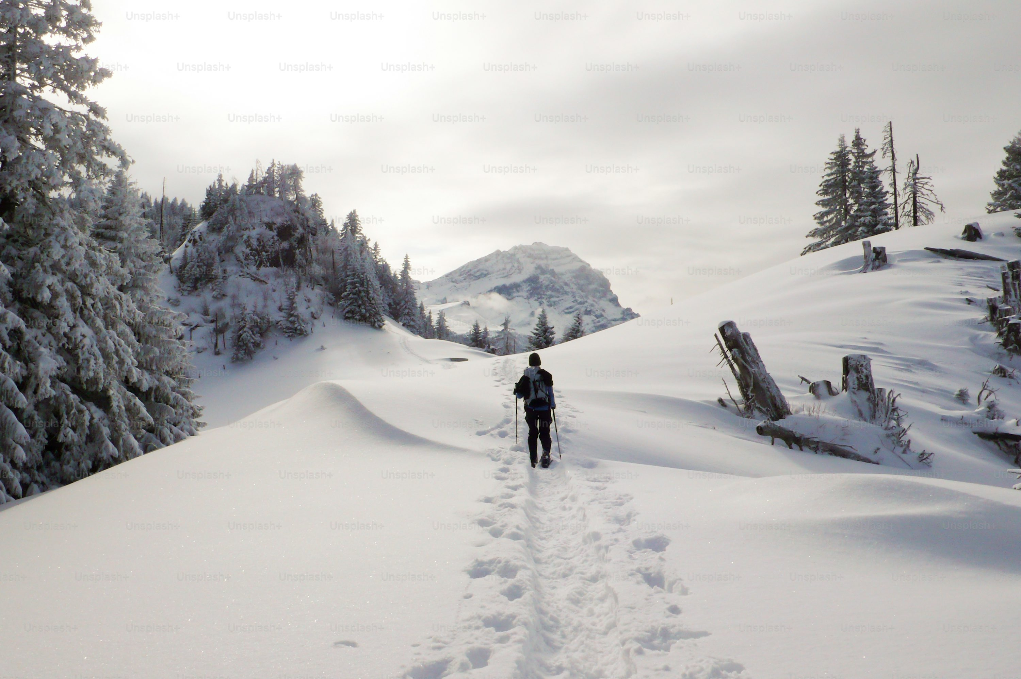
1. 目標
Notes:
https://unsplash.com/photos/female-hiker-with-snowshoes-hiking-in-the-alps-of-switzerland-in-pristine-and-idyllic-nature-wilderness-dULQWaYhb3s

Slide 3
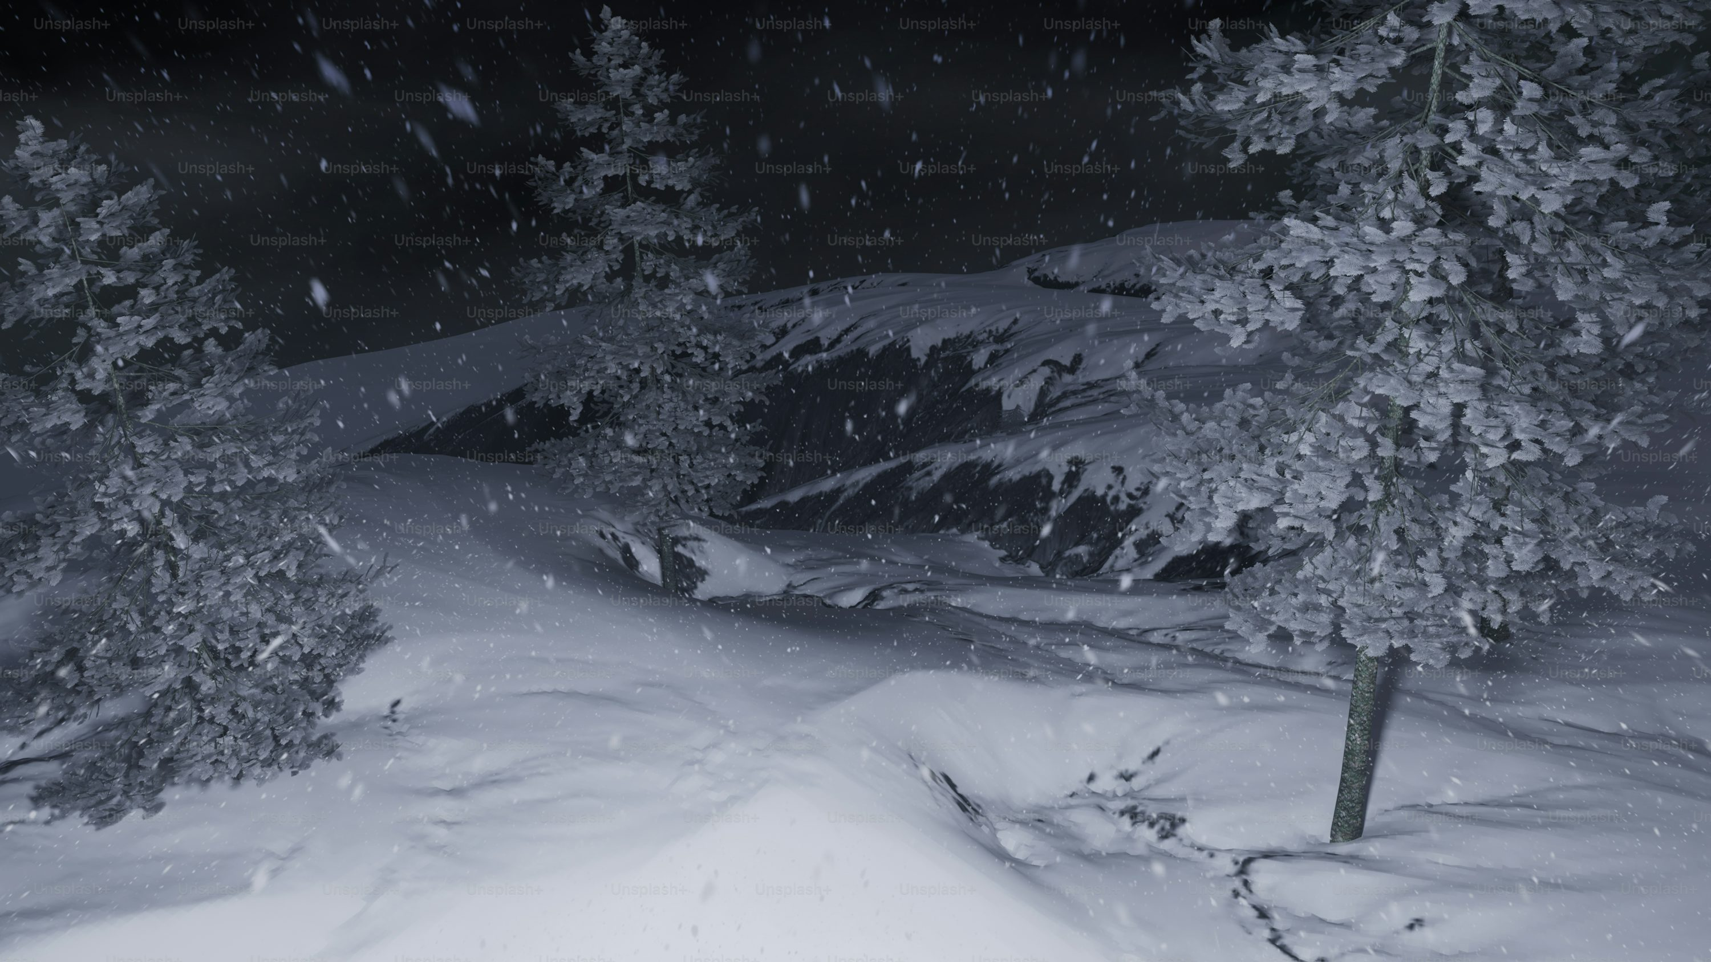
2. 阻礙
Notes:
https://unsplash.com/photos/a-snowboarder-is-going-down-a-snowy-hill-at-night-W4NvyMoHOuI

Slide 4
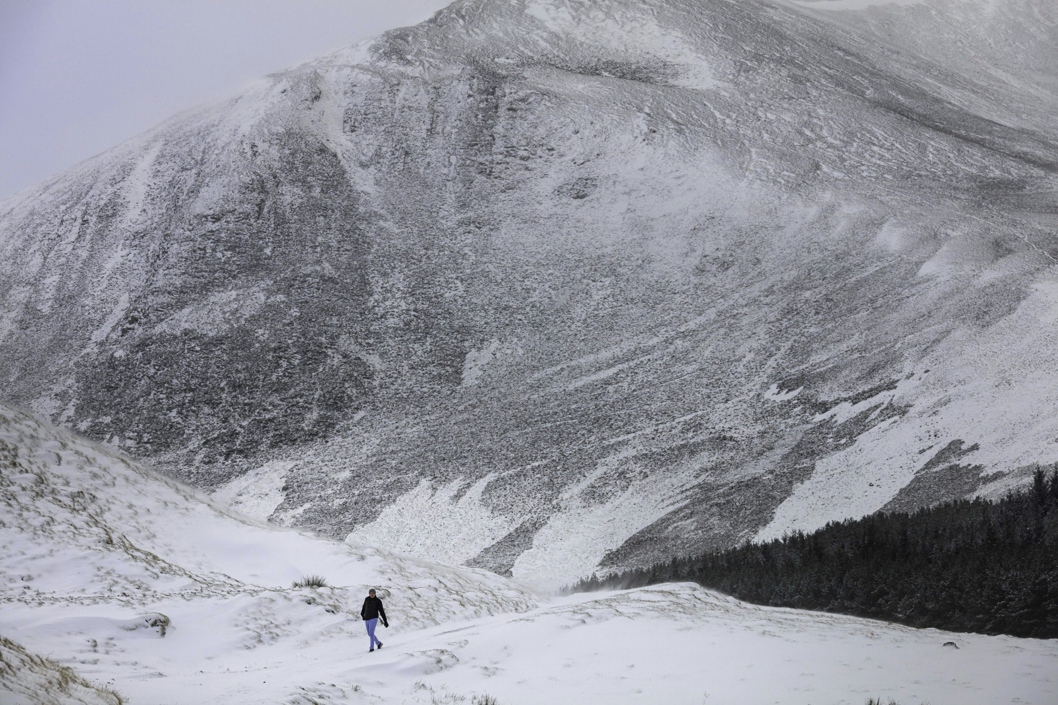
3. 努力
Notes:
https://unsplash.com/photos/a-person-walking-on-a-snowy-mountain-Hf1gchyMafE

Slide 5
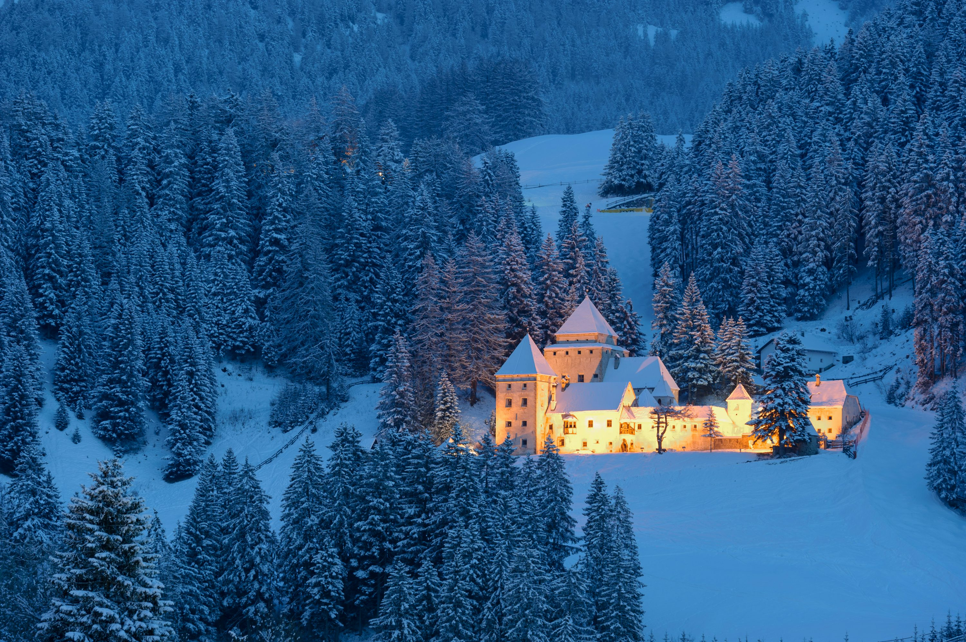
4. 結果
Notes:
https://unsplash.com/photos/white-castle-surrounded-by-pine-trees-6UnSrZnHe0M

Slide 6

5. 意外
Notes:
https://unsplash.com/photos/top-view-of-inspector-finding-an-injured-unconscious-storage-worker-laying-down-qpOWuGjUBns

Slide 7
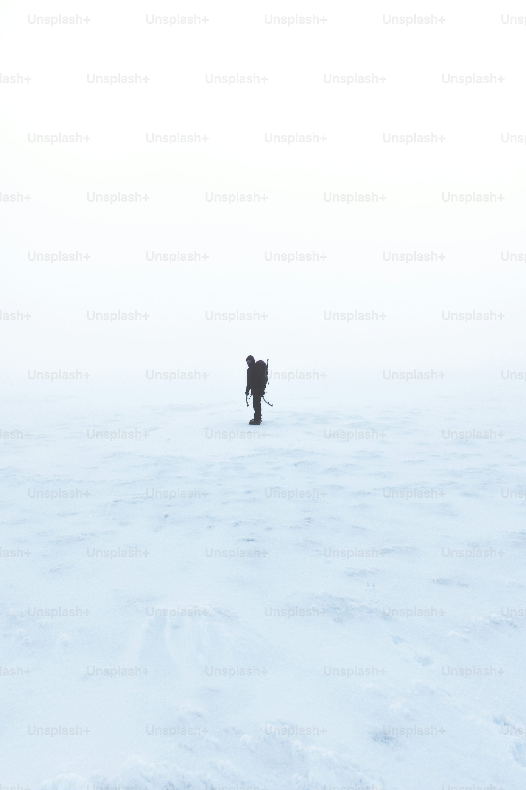
6. 轉彎
Notes:
https://unsplash.com/photos/a-person-walking-across-a-snow-covered-field-HTmalL59xzY

Slide 8

7. 結局
Notes:
https://unsplash.com/photos/asian-man-wake-up-late-in-the-morning-F0cwJQZonOY

